Slide 1






DEPARTMENT OF COMPUTER SCIENCE
COMP0016, 2020-21 - Team 06
Dashboard for Visualising Infusion Pump Data
Client: Gemma Renshaw, GOSH
Daulet Batayev
Henry Ching
Tianang Chen
daulet.batayev.19@ucl.ac.uk
henry.ching.19@ucl.ac.uk
tianang.chen.19@ucl.ac.uk

Slide 2
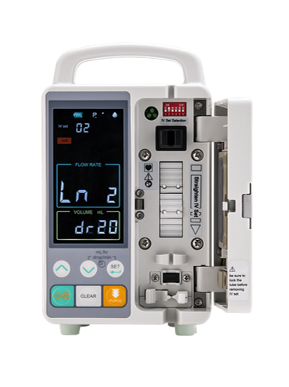
Motivation
Infusion pumps deliver nutrients and medications into a patient's body in controlled amounts.
GOSH has no digital system in place to monitor that feed data.
Often it is unclear if the patient is achieving the prescribed amount of feed.
False positives about the efficiency of the treatment plan.
Visualising the feed data will help clinicians get insights into the patient's body and adjust the treatment plan accordingly.

Slide 3
Proposed Solution
Scalable web application for visualising the infusion pump data.
Dashboard
Visualising the data, comparing current values to prescribed values
System Intelligence
Spot anomalies, i.e., spikes in rate.
Patient Treatment History
Clinician can review past data and compare it with feed current rates.
Feedback system
Patients can provide explanations to the changes in feed.

Slide 4

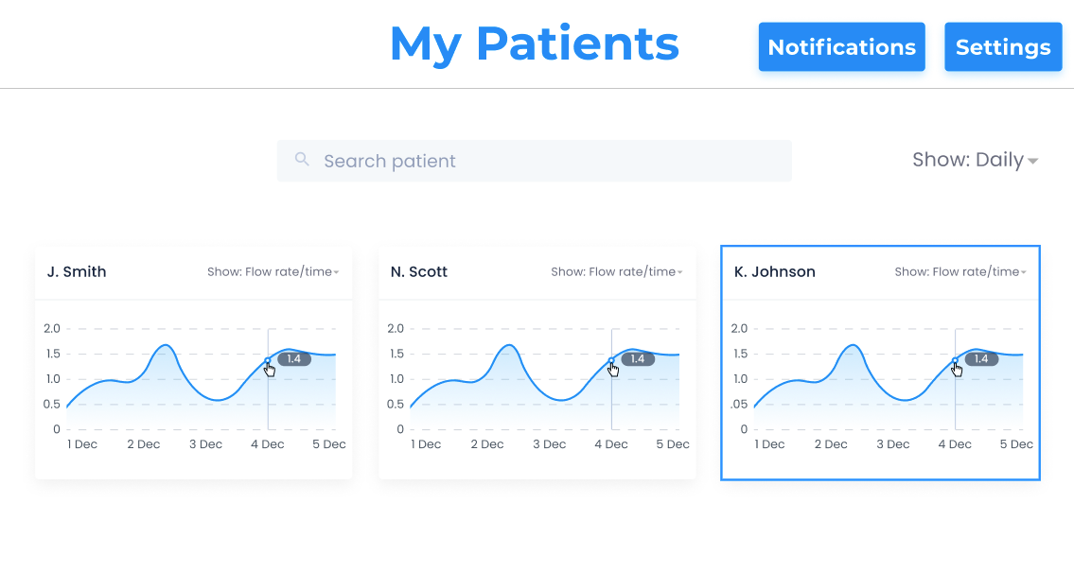
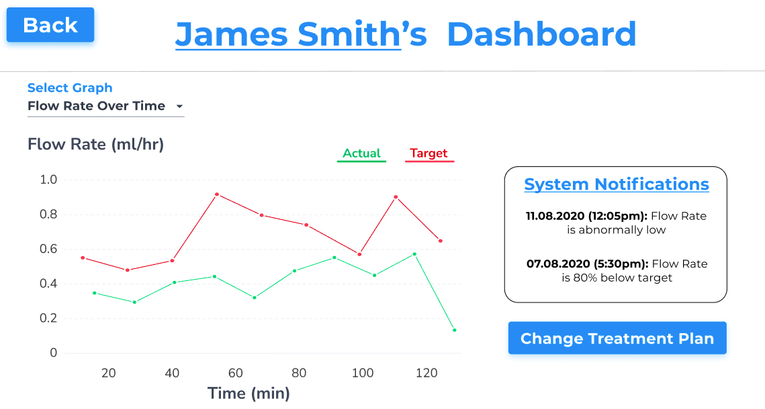
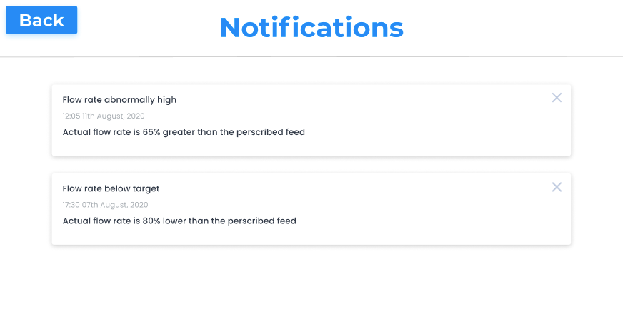
User Interface

Slide 5
Implications
Dashboard helps clinicians get insights into the patient's treatment.
The system intelligence can uncover patterns from long-term data.
Data analysis helps creating tailored treatment plans.
The entire treatment process is permanently stored in a database.

Slide 6
Thank you!
DEPARTMENT OF COMPUTER SCIENCE
GitHub https://github.com/COMP0016-Team6
Development Blog https://comp0016-team6.github.io/Dev-Blog/

